Slide 1

CPS 510
The Kernel and Meltdown
Jeff Chase
Duke University

Slide 2
Overview
Meltdown is a security flaw in many existing CPUs.
Discovered concurrently by three groups in late 2017.
At that time, it enabled an untrusted user process on any standard OS to read all of machine memory.
Is that bad? Yes: it breaks process isolation.
“All bets are off.”
Meltdown is instructive: it engages fundamentals of kernel entry and how OS manages memory and VM.
It illustrates concept of a side channel that can leak information across “hard” protection boundaries.

Slide 3
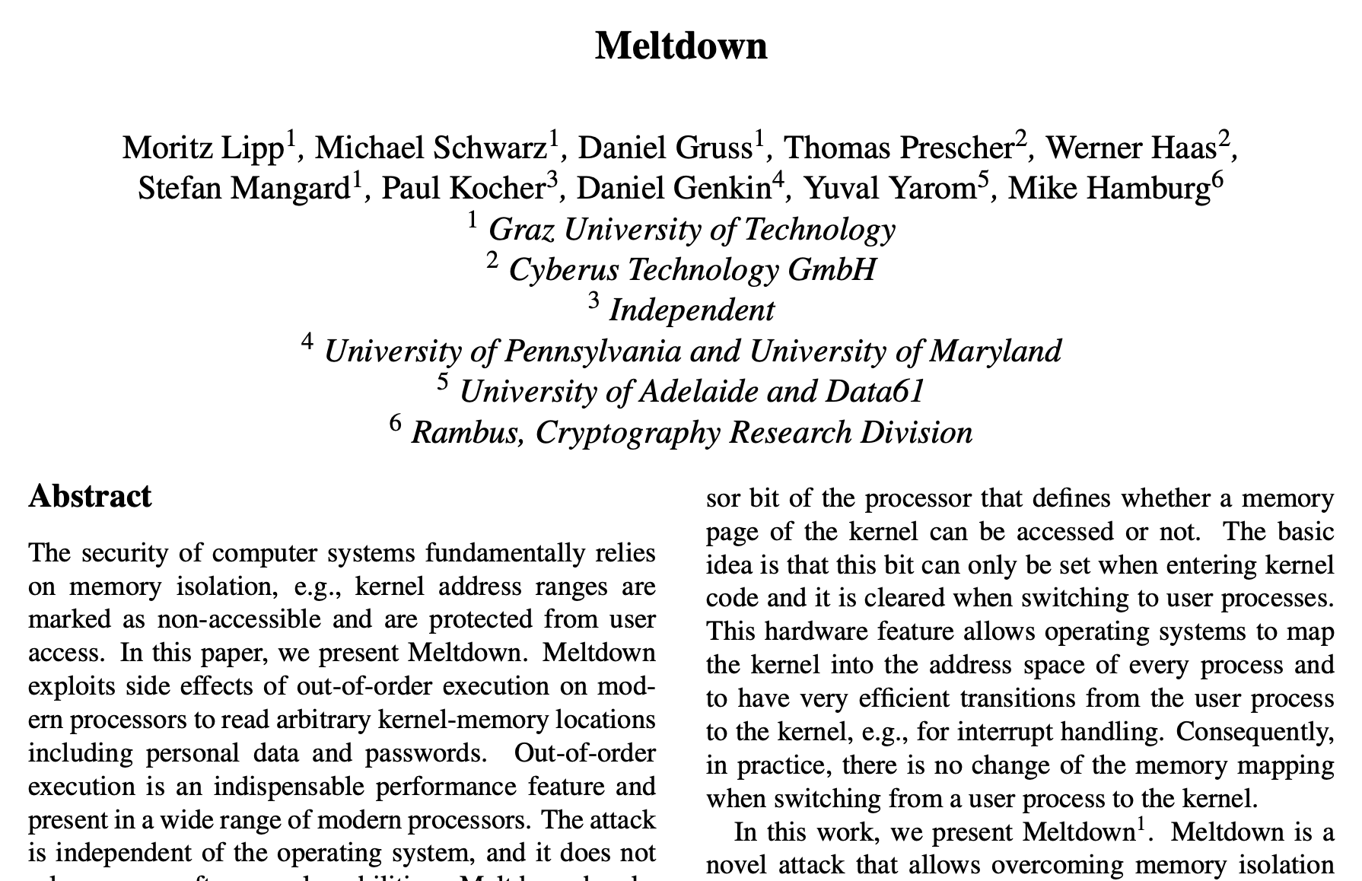
Meltdown
arXiv 2018

Slide 4

Entering the kernel
Suppose a CPU core is running user code in user mode:
The user program controls the core.
The core goes where the program code takes it…
…as determined by its register state (context) and the values encountered in memory.
How does the OS get control back?
CPU exceptions: trap, fault; interrupt
On these events the CPU transitions to kernel mode and resets the PC and SP registers.
Set the PC to execute a pre-designated kernel handler routine for that exception type.
Set the SP to a pre-designated kernel stack.
user
space
Safe control transfer
kernel
code
kernel
space
kernel
data

Slide 5
A note on kernel entry/exit
“It’s a trap!”
Not the same as a process/thread context switch!
Does not save/restore complete register context.
Simply transition to/from protected mode.
Sure, it changes PC and SP, and saves/restores some registers…just like a procedure call.
But: keep the same VAS loaded! E.g., leave CR3 alone.
To be precise: it is a mode switch not a context switch.

Slide 6
User space is mapped in kernel mode
It is often useful to access user VM (user space) from kernel code, i.e., when the core is running in kernel mode.
User program / user space
Syscall dispatch table indexed by syscall number.
user buffers
For I/O syscalls:
1. Devices DMA to/from page cache (file/buffer cache).
2. Kernel copies data to/from user-specified buffers in user space.
trap
copyout
copyin
Syscall routines copy args from user VM into kernel space, then validate them.
read() {…}
write() {…}
kernel

Slide 7
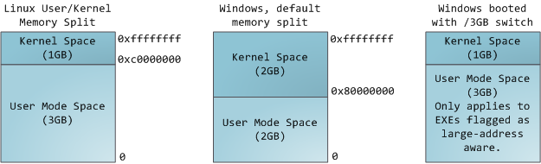
Map kernel space in user mode?
N
2 high-order bits set
1 high-order bit set
Before Meltdown, kernel was “present and mapped” in every process VAS (on typical systems/machines).

Slide 8
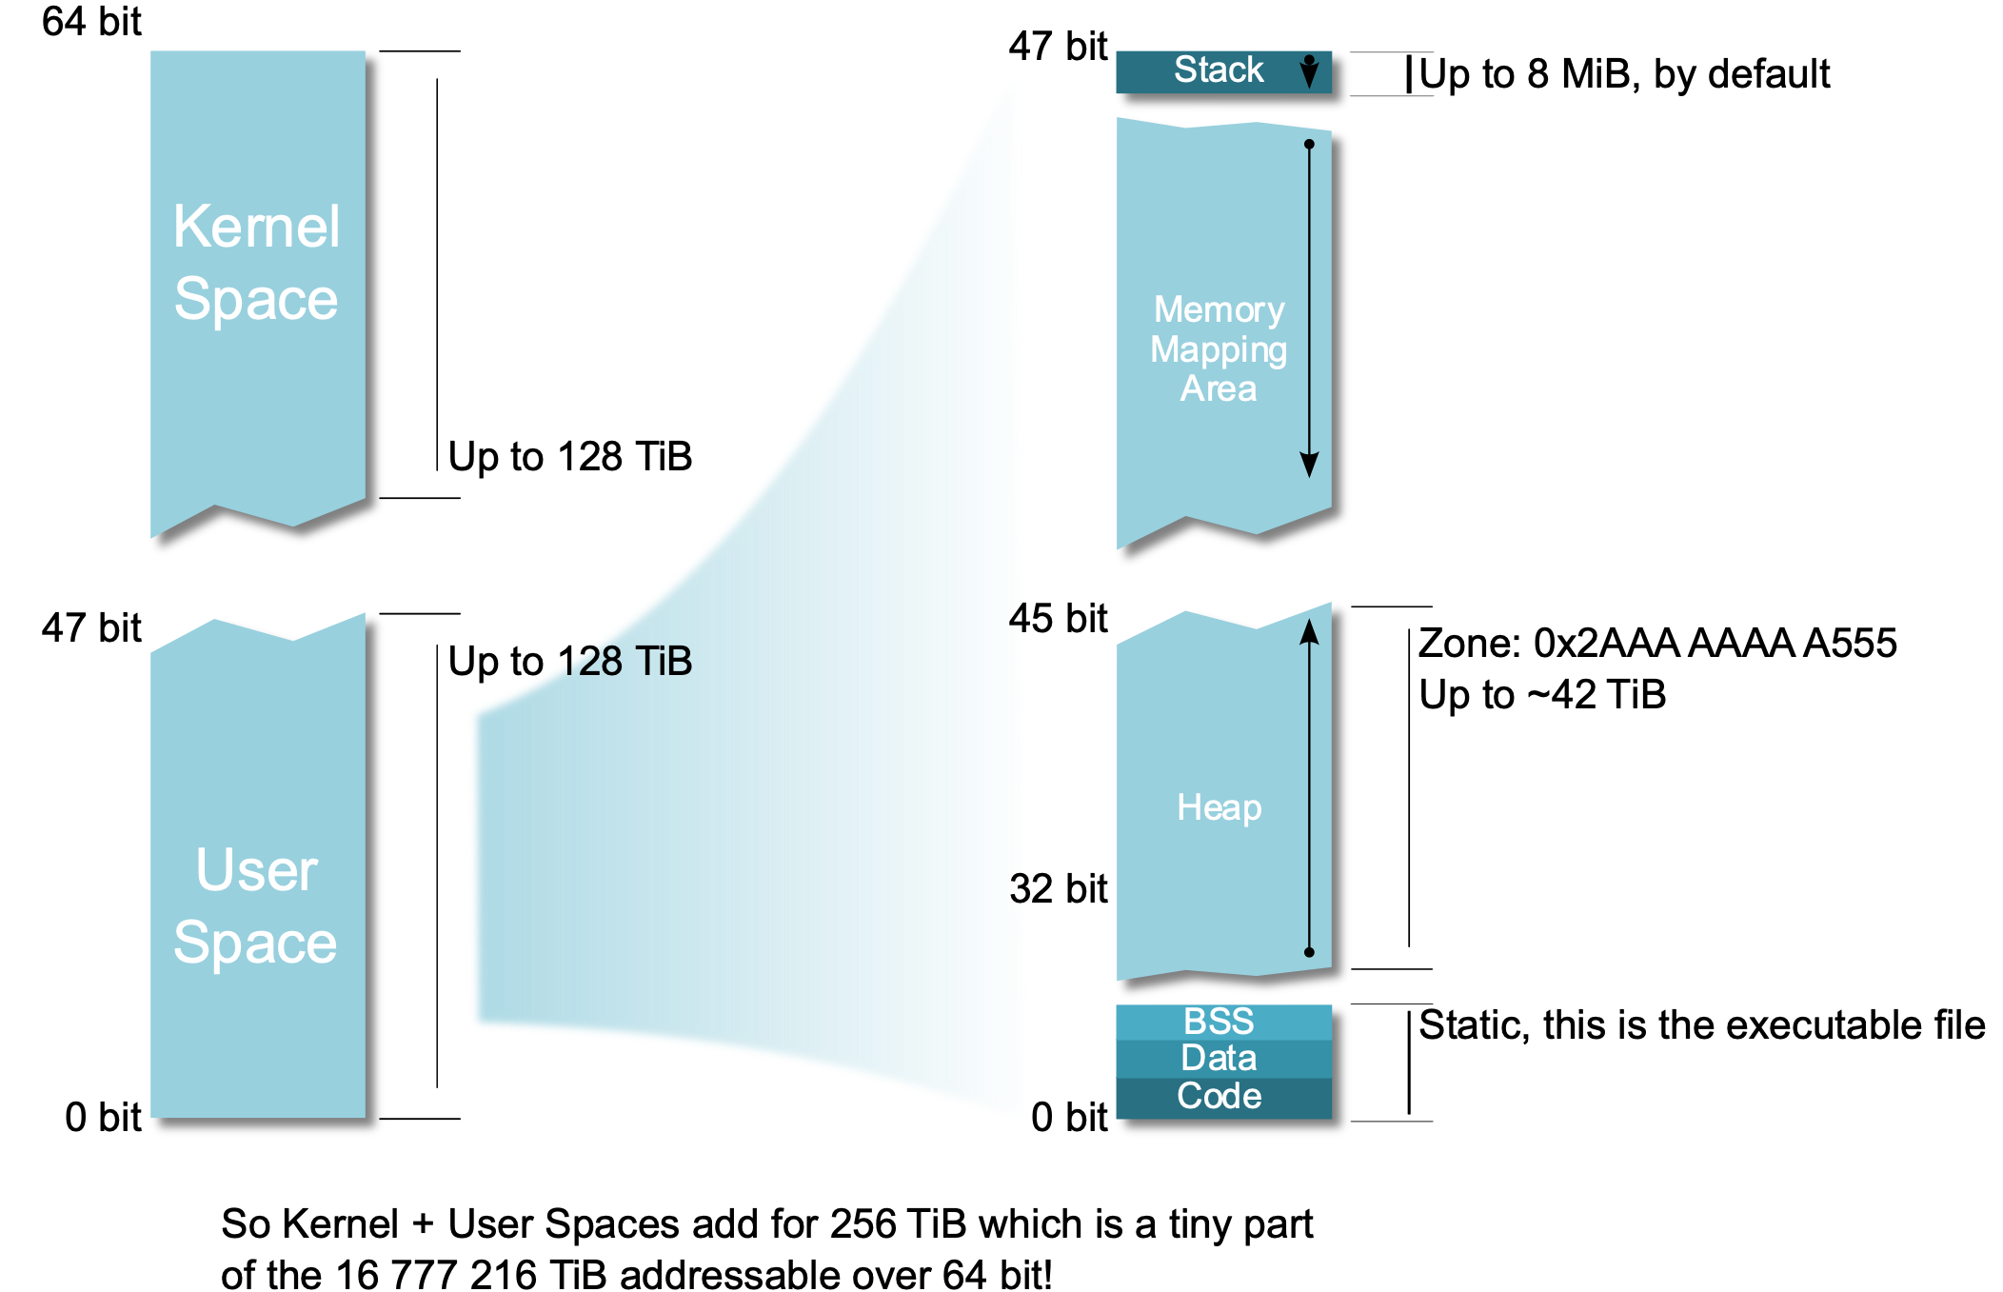
Another view of a Linux x86-64 VAS
https://upload.wikimedia.org/wikipedia/commons/2/29/Linux_Virtual_Memory_Layout_64bit.svg
Jean-Christophe Berthon / CC BY-SA (https://creativecommons.org/licenses/by-sa/3.0)

Slide 9
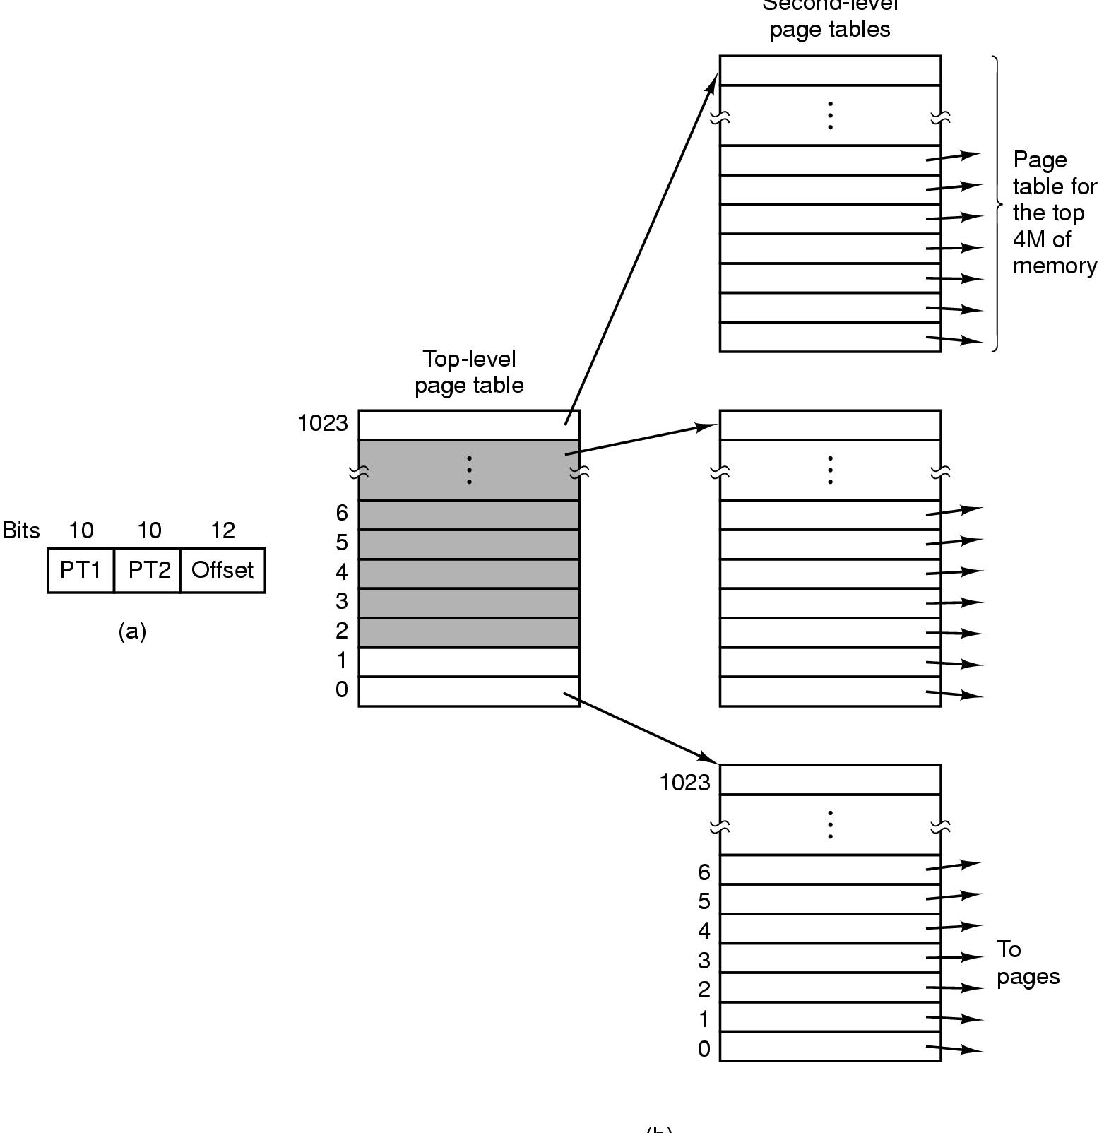
Why keep the kernel mapped in user mode?
We want system calls to be fast!
And faults, and interrupts.
Many CPUs have only one map register.
E.g., Intel CR3 for IA32 and x86-64.
We need the kernel mapped in kernel mode, but it is expensive to change the maps on each mode switch.
Solution: one big page table per VAS with kernel+user space; leave that map in place on kernel entry/exit.
So: kernel is mapped even when core is in user mode.
Convenient, easy, but is it safe? (No.)

Slide 10
Access kernel space from user mode?
KVA: kernel virtual address
load byte @KVA → R0 ; attempt a load from a KVA
shl R0, 0xc ; multiply byte value by page size
load @[_base+R0]→R0 ; load from array starting at _base
What happens when core hits instruction 1 in user mode?
fault!

Slide 11
Why raise a fault?
x86-64 PTE (Linux/Intel Core i7)
63
51
12
8
7
6
5
4
3
2
1
0
XD
PFN / PPN (40-bit)
G
0
D
A
CD
WT
U/S
R/W
P=1
U/S: accessible from user code?
Or only by OS (supervisor)?
Kernel space is mapped for access only in protected mode.
[from CS:APP3e F9.24: edited and not to scale]

Slide 12
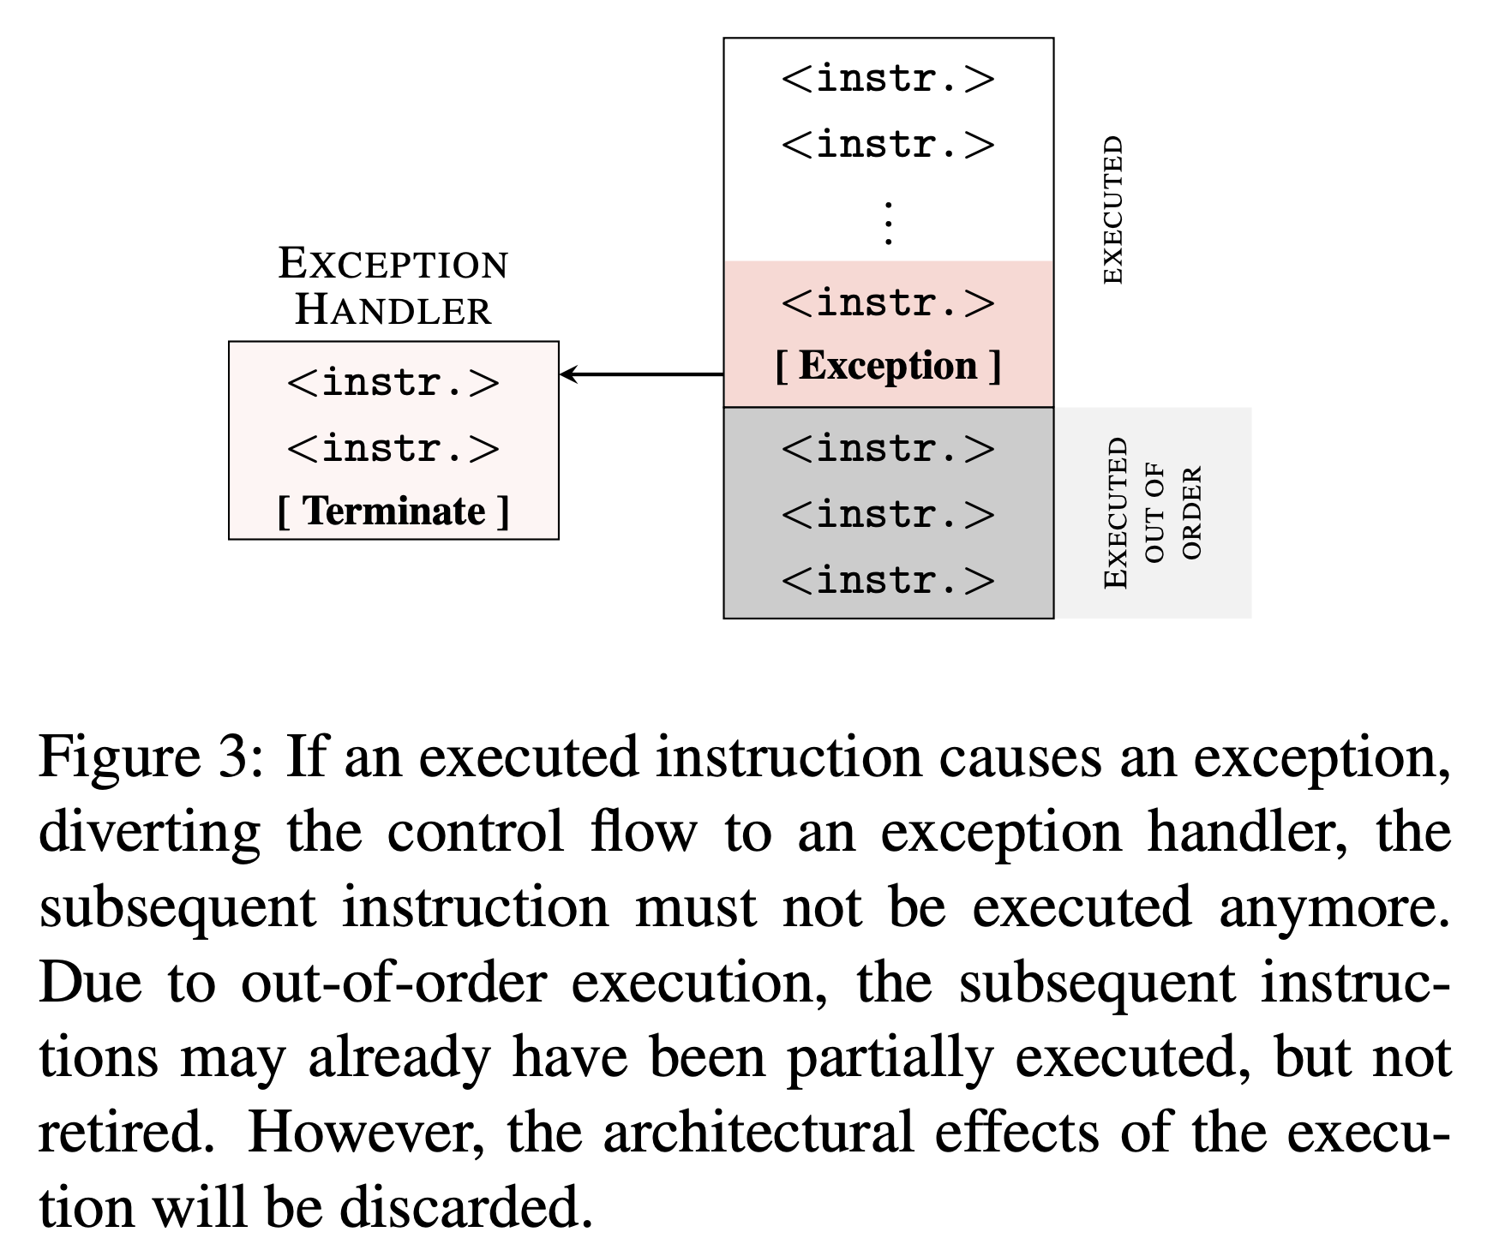
Precise exceptions
What happens when the core raises that fault?
Graphic from Meltdown (Figure 3)

Slide 13
Precise exceptions
Figure 3 of Meltdown paper
“If an executed instruction causes an exception, diverting the control flow to an exception handler:
the subsequent instruction must not be executed anymore.
Due to out-of-order execution, the subsequent instructions may already have been partially executed, but not retired.
However, the architectural effects of the execution will be discarded. “

Slide 14
Precise exceptions?
Above the red line:
CPU completes all instructions: their effects are in the register context when fault is raised.
Below the red line:
CPU may speculatively execute instructions, but it quashes any effects on registers or memory when the control flow changes for the fault.
When does the core detect the access violation? Not until it has the PTE for that KVA.
Graphic from Meltdown
Graphic from Meltdown (Figure 3)

Slide 15
Side effects of discarded instructions
The problem: speculative loads/stores may affect caches, even if discarded with no effect on memory or registers.
“Although the instructions … do not have any visible architectural effect on registers or memory, they have microarchitectural side effects… the referenced memory is fetched….and stored in the cache. If…discarded, the register and memory contents are never committed. Nevertheless, the cached memory contents are kept in the cache. We can leverage a microarchitectural side-channel attack such as Flush+Reload [35], which detects whether a specific memory location is cached, to make this microarchitectural state visible. “

Slide 16
Meltdown exploit (cartoon version)
load byte @KVA → R0 ; attempt a load from a KVA
shl R0, 0xc ; multiply byte value by page size
load @[_base+R0]→R0 ; load from array starting at _base
These instructions below the red line may impact the cache.
@_base is a 256-page array (probe_array in the paper).
One page per possible byte value @KVA.
If first cache line of only page x is in the cache, then the value of byte@KVA is x. (Flush the cache first.)

Slide 17
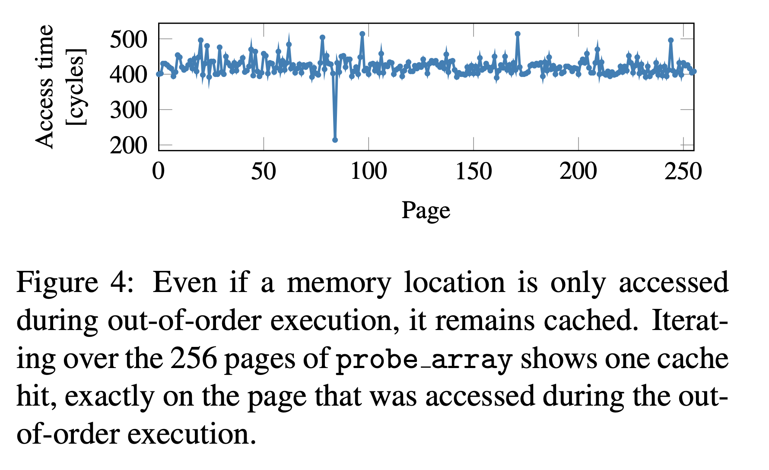
Timing the loads
Recovered byte value = 84
Graphic from Meltdown

Slide 18
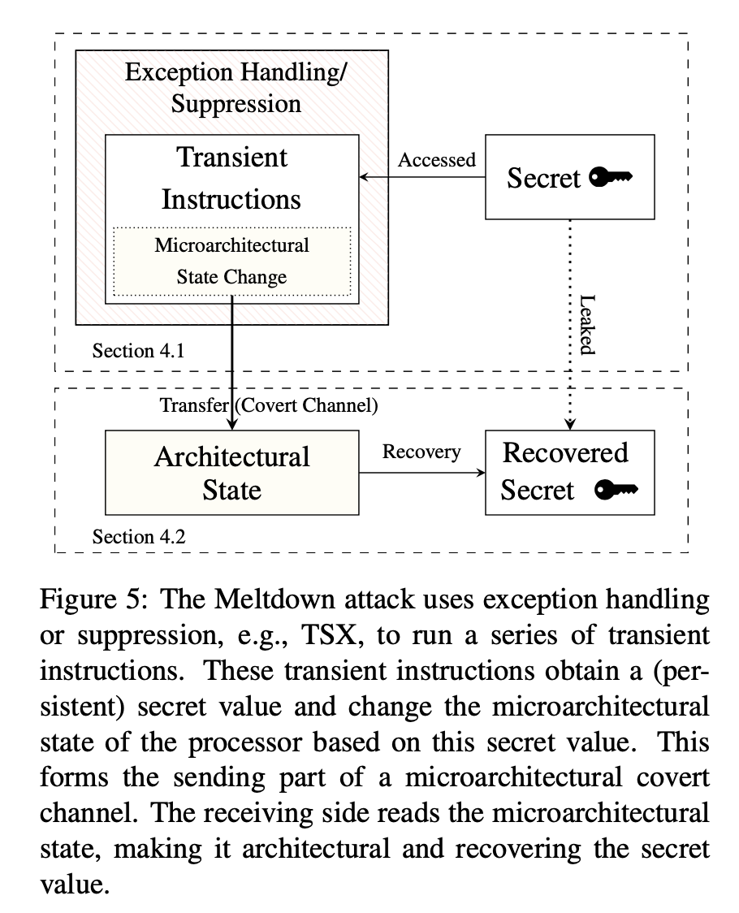
Iterate
Read all of kernel VM.
One byte at a time!
How to do it fast?
Use other features (TSX) to suppress costly exceptions.
(Though unprivileged KVA loads still fail.)
But wait! It gets worse….
Graphic from Meltdown

Slide 19
Machine memory is mapped in kernel space
Why?
Graphic from Meltdown

Slide 20
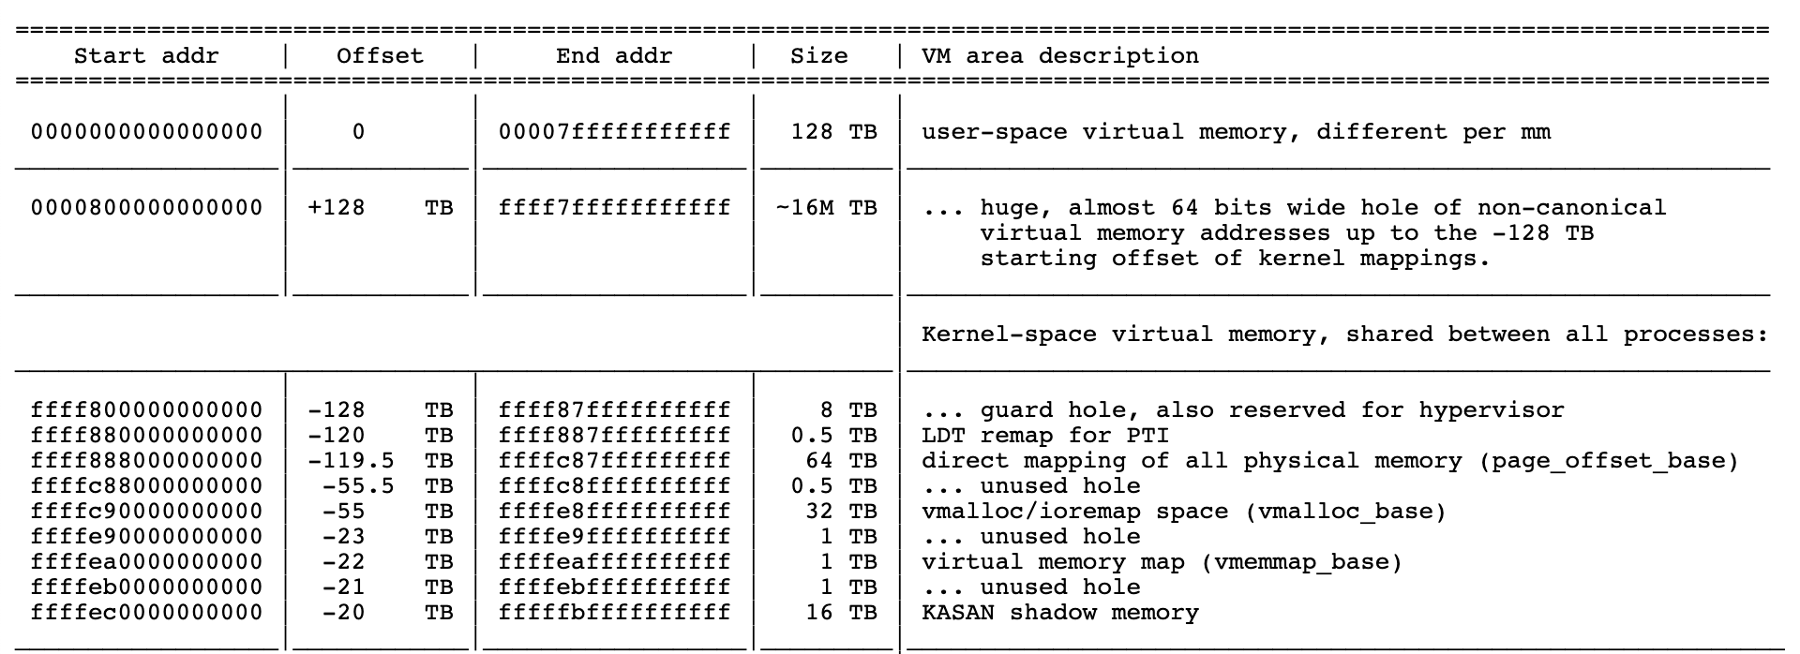
All “physical” memory is exposed
https://www.kernel.org/doc/Documentation/x86/x86_64/mm.txt
Kernel keeps physical memory mapped into kernel VM so that it can operate on arbitrary frames—e.g., to zero them out without mapping to user VM. Convenient…but is it safe?

Slide 21
Meltdown is a CVE
Listed in US National Cybersecurity database of Critical Vulnerabilities and Exposures (CVE).
Vulnerability. “A weakness in…software [or] hardware components that, when exploited, results in a negative impact to confidentiality, integrity, or availability.”
Exploit. Attack code usable by an adversary to take advantage of a vulnerability to impact a target system.
Mitigation. To defend against a CVE “typically involves coding changes, but could also include…[anything]”
How to mitigate Meltdown?

Slide 22
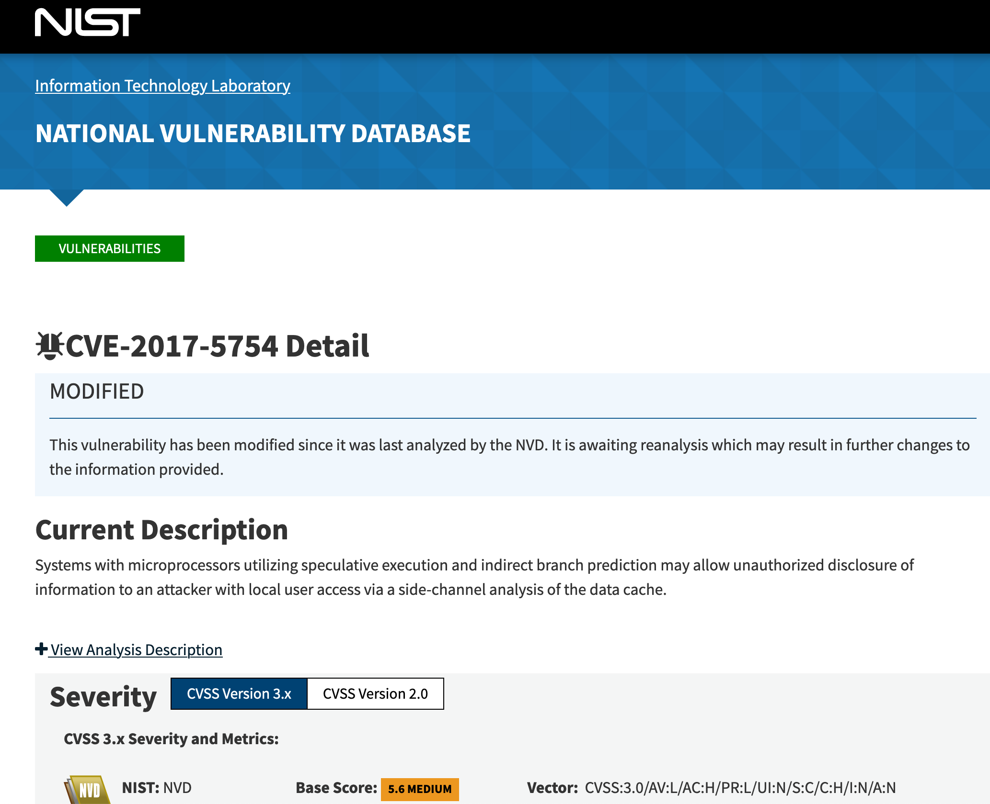
National Vulnerability Database

Slide 23
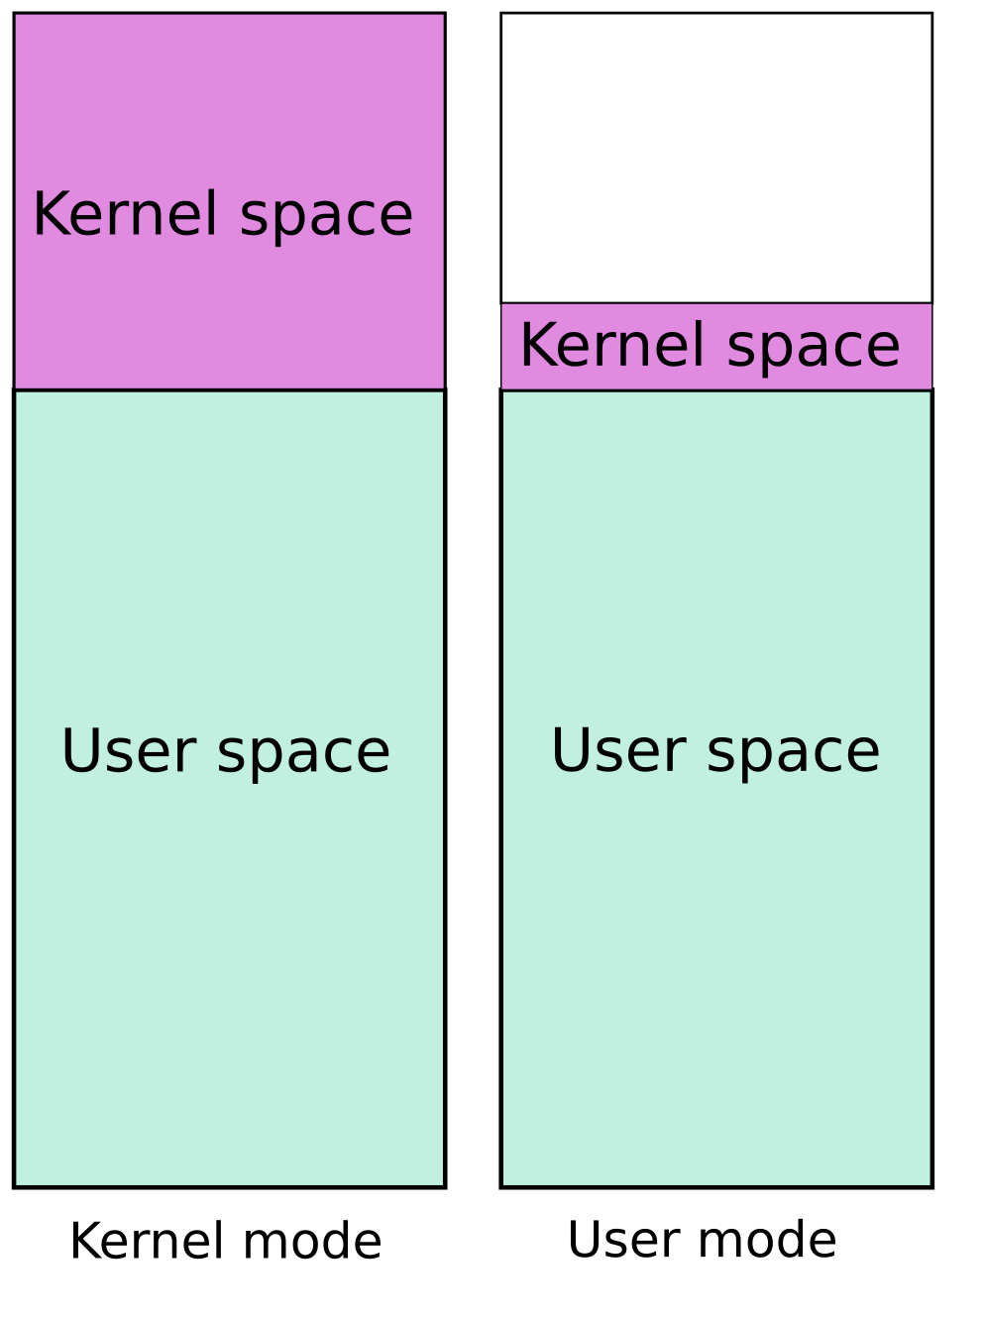
Defense: protecting kernel space
Maintain and use two complete page tables (pmaps) per VAS.
In kernel mode: activate (e.g., via CR3) the classic map, with both user space and kernel space.
In user mode: activate a stripped-down map with user space but only minimal portions of kernel space needed to enter kernel for traps, faults, and interrupts.
It is called Kernel Page Table Isolation (KPTI), formerly “KAISER”.
Defends against Meltdown.
At what performance cost?
Graphic from KAISER: hiding the kernel from user space. By Jonathan Corbet LWN.net, 2018.

Slide 24
Costs of KPTI
“Just the new instructions (CR3 manipulation) add a few hundred cycles to a syscall or interrupt.” (Or fault.)
What workloads are impacted?
Lots of I/O? Lots of system calls? Ouch. (1%-35%+)
Just computing? Not so much.
May also require TLB flushes for full defense.

Slide 25
Can the architecture help?
Ditch speculative execution????
Squash dangerous speculative code paths before they affect the cache.
E.g., as in AMD’s micro-architecture
Detect access violation immediately, before TLB lookup.
Maybe per-PTE user/kernel access bit is just a bad idea.
Idea: distinguish kernel space by high-order address bit. Optionally disallow all access from user mode.
Stick with KPTI, but reduce cost of map switches by avoiding TLB flush.
Many CPUs—including recent Intel CPUs—tag the TLB with a space identifier (ASID or “PCID”): no TLB flush required.

Slide 26

Attacking the foundations

Slide 27

Alex Stamos
Former chief of security at Yahoo and Facebook.
Consulting @Zoom for security as it scales up.
Now at Stanford teaching software safety/security.
“Security is about breaking the layers of abstraction in a system. Computers are so complex that the people that program them have to make basic assumptions about how they work. And it turns out those basic assumptions are often false: they’re good enough to go build something that works, but not to build something that works securely. So studying computers down to the lowest level can often be a really good skill.”

Slide 28
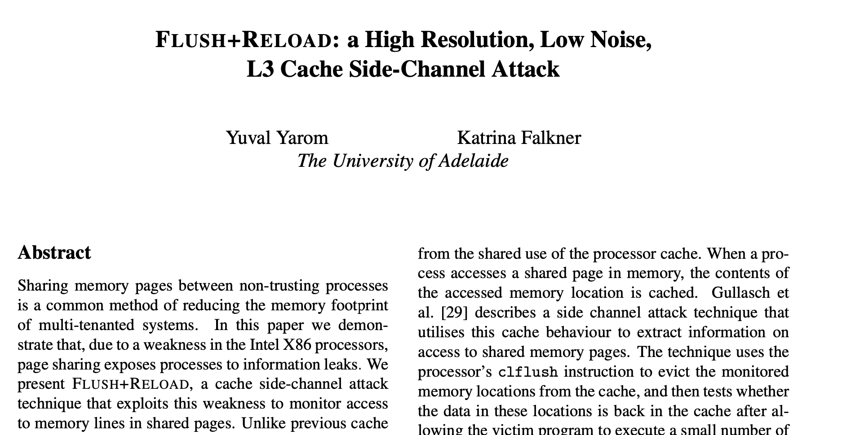
A cache side-channel attack
Proceedings of the 23rd USENIX Security Symposium, 2014

Slide 29
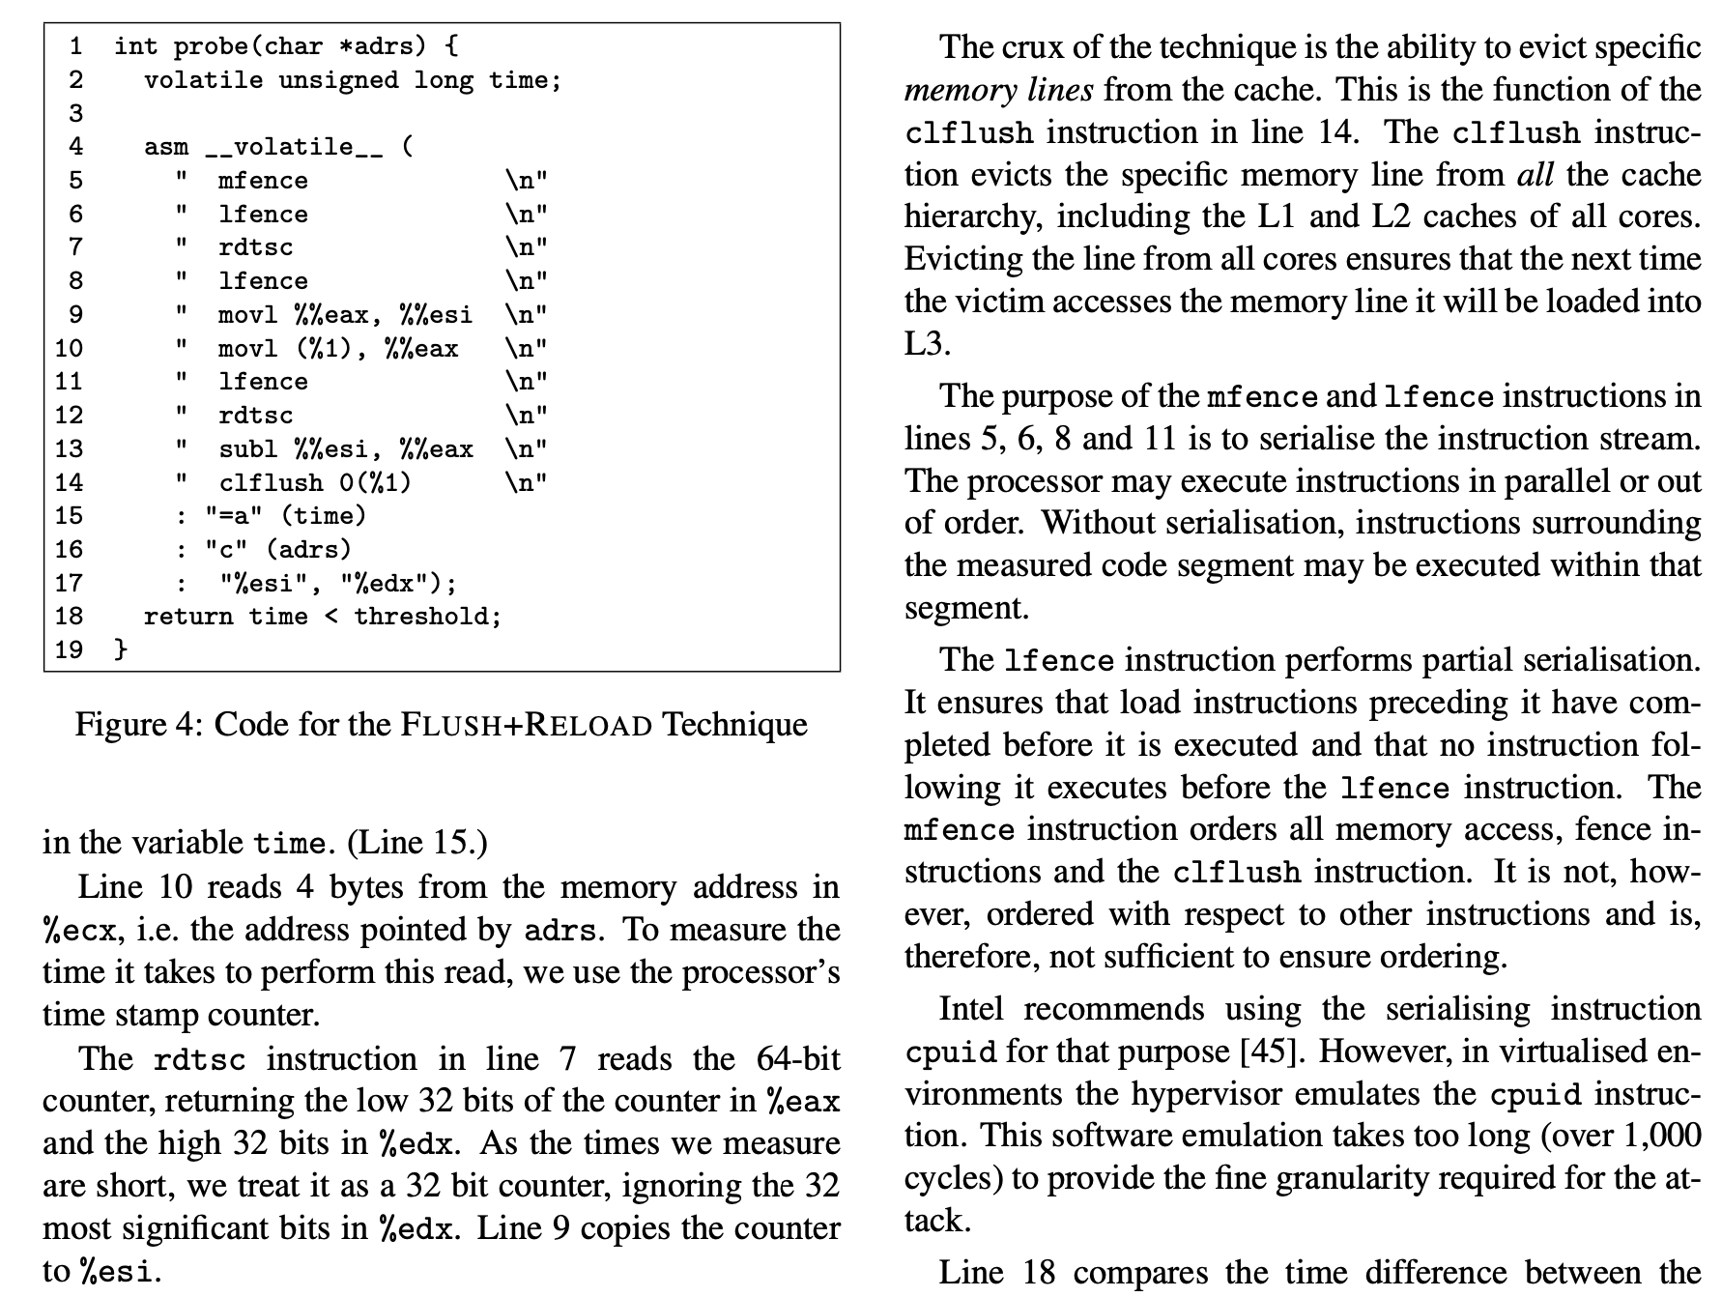
Flush+reload: details

